Slide 1
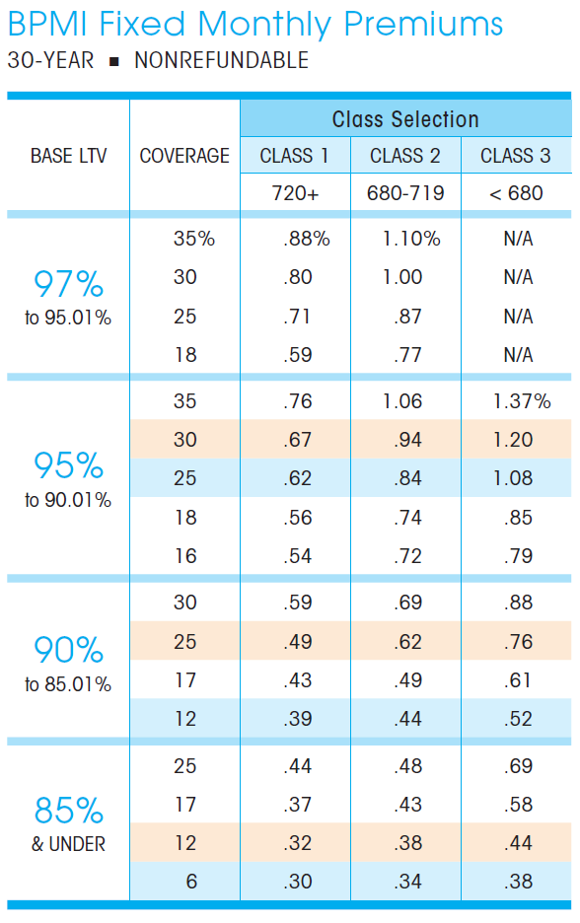

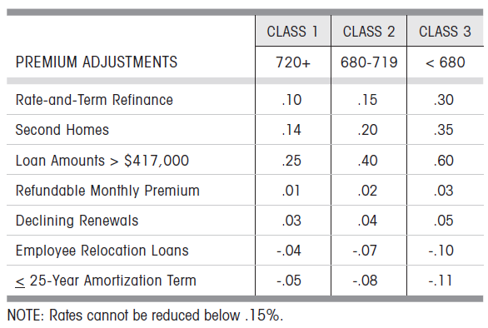
Current MI Calculation
Example Loan:
Loan Seq Num: U60490000208
Step 1: Find the right version of MIGC document based on loan origination date
firstPaymtDt | 4/1/2011
cs | 781
origLTV | 121
loanPurposeType | RE-FI-NCO
occType | OWNER
originalLoanAmount | 89320
pctMtgIns | 20
origPMI | 1.83

Slide 2
Current MI Calculation
Example Loan:
Loan Seq Num: U60490000208
Step 2: Find the MI premium based on loan info
firstPaymtDt | 4/1/2011
cs | 781
origLTV | 121
loanPurposeType | RE-FI-NCO
occType | OWNER
originalLoanAmount | 89,320
pctMtgIns | 20
As LTV greater than the largest number in the table, we assigned the max number (or a number of 1000 bps) to the base MI.
We will have a PMI of 110 bps for the loan.

Slide 3
Current MI Calculation
Example Loan:
Loan Seq Num: U60490000208
firstPaymtDt | 4/1/2011
cs | 781
origLTV | 121
loanPurposeType | RE-FI-NCO
occType | OWNER
originalLoanAmount | 89,320
pctMtgIns | 20
110 bps is miss leading, as the HARP loan borrowers pay no MI or carry over their MI from previous loan.
We need to find out what’s the MI HARP borrowers were paying before they refinance.
Problem:
We don’t have information for their previous loan.
As LTV greater than the largest number in the table, we assigned the max number (or a number of 1000 bps) to the base MI.
Passible solution:
One information we can use is the pctMtgIns which is the MI coverage level.
We could use the coverage level to look up MI rates from MGIC documents before 2009/06.
We will have a PMI of 110 bps for the loan.

Slide 4
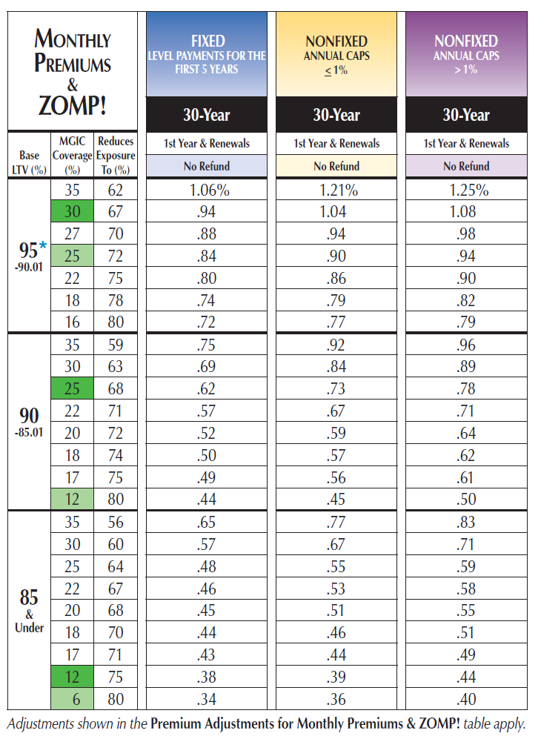

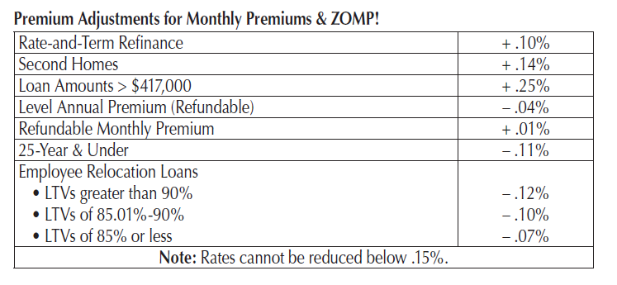
Update MI Calculation
Example Loan:
Loan Seq Num: U60490000208
Step 1: Find the historical version of MIGC document before June 2009
firstPaymtDt | 4/1/2011
cs | 781
origLTV | 121
loanPurposeType | RE-FI-NCO
occType | OWNER
originalLoanAmount | 89,320
pctMtgIns | 20

Slide 5
Update MI Calculation
Example Loan:
Loan Seq Num: U60490000208
Step 2: Look up the MI coverage
firstPaymtDt | 4/1/2011
cs | 781
origLTV | 121
loanPurposeType | RE-FI-NCO
occType | OWNER
originalLoanAmount | 89,320
pctMtgIns | 20
Problem:
We have 20% MI coverage for each of the LTV buckets

Slide 6
Update MI Calculation
Example Loan:
Loan Seq Num: U60490000208
Step 2: Look up the MI coverage
firstPaymtDt | 4/1/2011
cs | 781
origLTV | 121
loanPurposeType | RE-FI-NCO
occType | OWNER
originalLoanAmount | 89,320
pctMtgIns | 20
Problem:
We have 20% MI coverage for each of the LTV buckets
Solution:
Check the LTV distribution of loans with MI coverage of 20%. Choose the LTV bucket with the majority of loans fall in.

Slide 7
Update MI Calculation
Example Loan:
Loan Seq Num: U60490000208
Step 2: Look up the MI coverage
firstPaymtDt | 4/1/2011
cs | 781
origLTV | 121
loanPurposeType | RE-FI-NCO
occType | OWNER
originalLoanAmount | 89,320
pctMtgIns | 20
From the historical MI document, we assign 52 MI to the example loan, instead of 110 bps.
Makes the incentive 58 bps lower.

Slide 8
A suggested MI coverage look up table
Step 2: Look up the MI coverage
MI From | To | MI Premium
-1000 | 0 | 0.00
0 | 6 | 0.34
6 | 12 | 0.44
12 | 17 | 0.49
17 | 20 | 0.52
20 | 25 | 0.62
25 | 30 | 0.94
30 | 999 | 1.06

